Slide 1

Topic Modelling Safety
Kelvin Chow

Slide 2
Objective
North Carolina State Government had set aside a budget to local authorities to address public concern and safety
Minimise life-lost and serious injuries
Where to spend on?

Slide 3
Agenda
Data
Natural Language Processing (NLP)
Topic Modelling (LSA)
Conclusion

Slide 4




Tools

Slide 5
Data
Survey and databases
2,114 tweets on a single day in NC
Category: Real disasters
A tweet : ”Arsonist sets cars ablaze at dealership https://t.co/gOQvyJbpVI”

Slide 6
NLP & LSA
1) Remove
Web links
Punctuations
Numbers
Stop words
2) Convert all text to lower case
3) Latent Semantic Analysis (LSA) with Bigram & k = 10

Slide 7
Topics
Thunderstorm
Tornado
Train Accident
Volcano Eruption
Sinkhole
Nuclear Meltdown
Hail Storm
Virus Outbreak
Terrorist Bombing
Electrocution

Slide 8
Topics
Thunderstorm
Tornado
Train Accident
Volcano Eruption
Sinkhole
Nuclear Meltdown
Hail Storm
Virus Outbreak
Terrorist Bombing
Electrocution
severe thunderstorm, thunderstorm warning, weather alert
Tornado flattened, powerful tornado, flattened home
Train derailed, derailed freight, speed derailment, India
Eruption intense, hazardous eruption, Philippines
Sinkhole killed, sinkhole swallows, huge sinkhole, China
Nuclear disaster, years nuclear, fukushima, Japan
Hail possible, size hail, heavy rain
Virus killed, virus quarantined, mystery virus, China
suicide bombing, bombing rises, bombing visits, Pakistan
Wire Electrocute, electrocute millions, electric wires

Slide 9
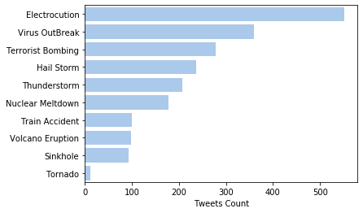
Topics

Slide 10
Topics
NA (China)
NA (Pakistan)
NA (Japan)
NA (India)
NA (Philippines)
NA (China)

Slide 11

Next Steps

Slide 12
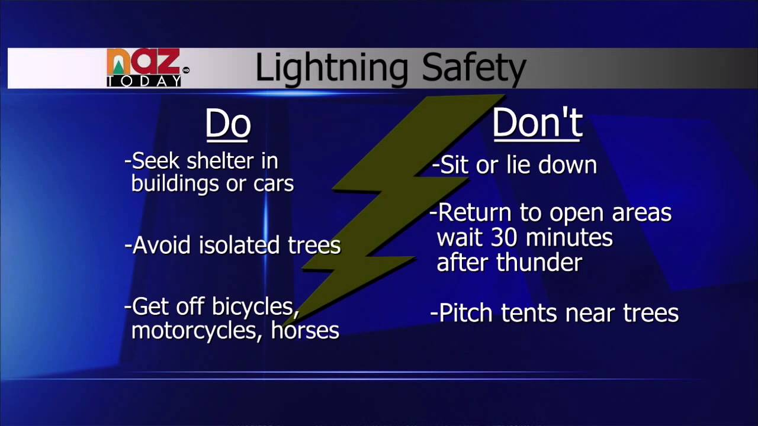
Next Steps

Slide 13
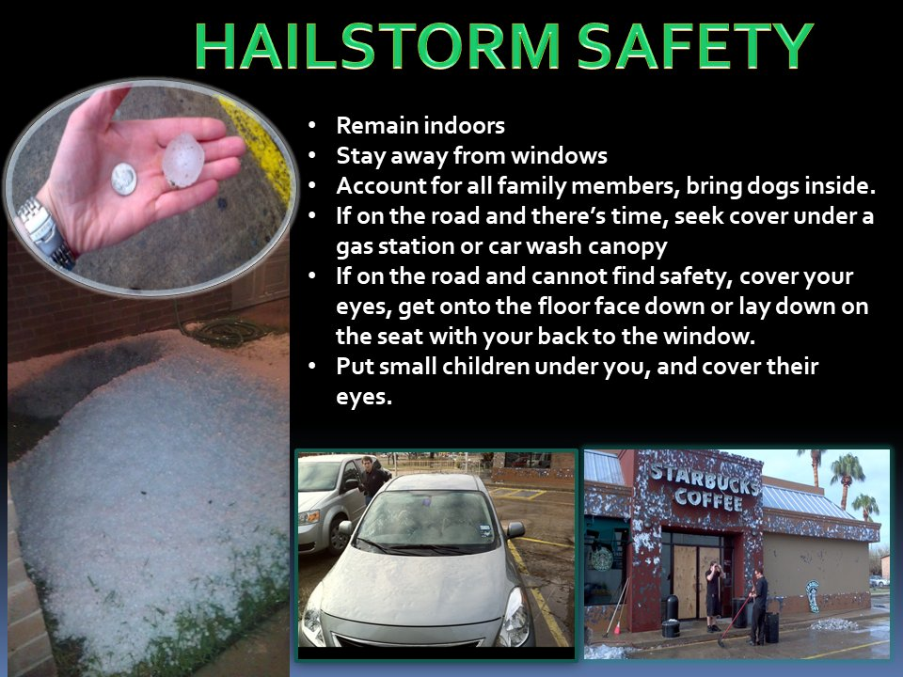
Next Steps

Slide 14
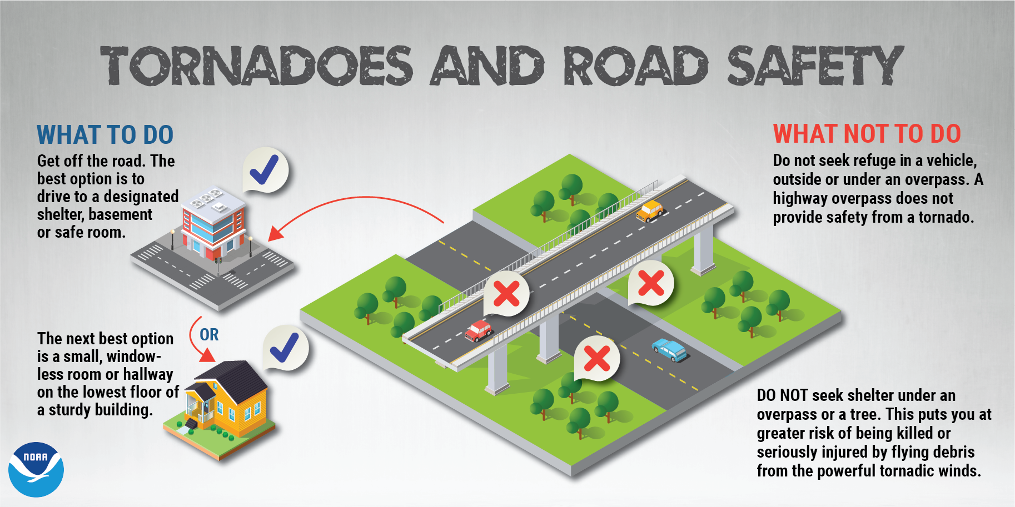
Next Steps

Slide 15
Conclusion
Get more data in extended period and other posts medium or news platform
Surveys
Work on the plan to implement safety (Awareness, Infrastructure)

Slide 16

Thank You
Kaggle: https://www.kaggle.com/kelvinchow1979
LinkedIn: https://www.linkedin.com/in/kelvin-chow-3a8b678/
Medium: https://medium.com/@kel_line
GitHub: https://github.com/Kelvinchow79

